Slide 1
PRESENTATION ON EVM & VVPAT
September 2019.

Slide 2
AGENDA
History
Technical Expert Committee (TEC)
Technical Security
Administrative safeguards
Debate around EVMs- Explained
Aspersions Vs. Confidence
Past Judgements
VVPAT
Notes:
this presentation covers the journey of EVM covering legal, technical and administrative aspects.

Slide 3
HISTORY OF EVM
Four Decades and more

Slide 4
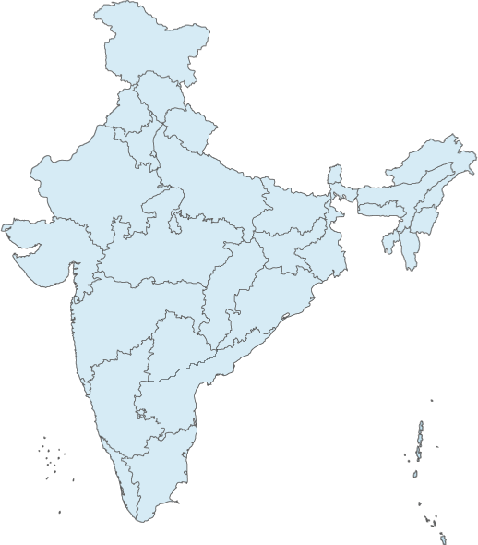
HISTORY OF EVM – 40 YEARS
1977
CEC- S L Shakdar talked about introducing an Electronic machine.
1980-81
EVMs developed and demonstrated by ECIL and BEL.
1982-83
EVMs used first time in 50 polling stations of Parur AC in Kerala. And then in 11 Assembly Constituencies: 8 states, 1UT.
1984
SC suspends EVM usage: cannot be used till RP Act is amended.
1988
2018
RP Act amended: enabling use EVMs wef 15.03.1989.
SC dismissed petition asking for return to Ballot papers!
Since 2000, EVMs have been used in all elections: 4 Lok Sabha and 122 State Legislative Assemblies. Till date, >315 crore votes cast on EVMs.
Notes:
EVM system has evolved over 40 years and have been in use in all elections since 2000

Slide 5
TECHNICAL EXPERT COMMITTEE
INDEPENDENT EVALUATION

Slide 6
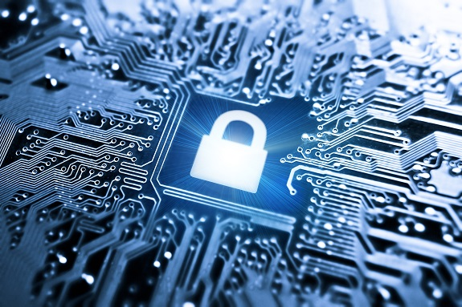
T E C- HISTORY & ROLE
TEC constituted for evaluation of upgraded EVMs Submitted an Evaluation Report in 2006
1st Technical Expert Committee (TEC) formed
January, 1990
December 2005
November 2010
April 1990
Current TEC
Approves EVM Design
Vets and seals the software
Recommends continuous design improvement
Monitors Secure Manufacturing
Recommended use of the EVMs unanimously
Notes:
Commission is aided by a Technical Expert Committee comprising of 4 eminent Professors from IITs, each of whom are renowned specialists in their fields. Prof Shahani present here heads the TEC and is one of the finest electronics expert. Prof Moona also present here is currently Director of IIT Bhilai and was till recently heading CDAC which has given India the supercomputer PARAM.

Slide 7
Past TECs
Composition of First Technical Expert Committee on EVMs – 1990
Professor S. Sampath, Chairman Technical Advisory Committee, Defence Research & Development Organization DRDO), Ministry of Defence.
Professor PV Indiresan of the IIT Delhi.
Dr. Rao C. Kasarabada, Director, Electronic Research & Development Centre (ERDC), Trivandrum.
Composition of Second Technical Expert Committee – Dec 2005
1. Prof P.V. Indiresan, Ex-Director, IIT Madras as Chairman of TEC.
2. Prof. D.T. Shahani of IIT Delhi.
3. Prof. A.K. Agarwala of IIT Delhi.

Slide 8
PRESENT TEC COMPOSITION
4 Eminent Professors from IITs: Renowned Experts in their Fields.
2
1
3
4
Prof D T Shahani,
Prof Emeritus, IIT-Delhi
Prof Rajat Moona,
Director IIT Bhilai,
Former Director General CDAC
Prof A K Aggarwala,
IIT Delhi
Prof Dinesh K Sharma,
Prof Emeritus, IIT Bombay

Slide 9
TECHNICAL SECURITY
DESIGN, PROCESS AND MANUFACTURING

Slide 10
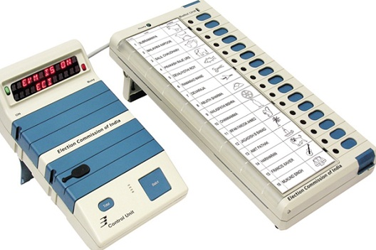
1. SECURED DESIGN FEATURES
Population
Date and Time Stamping of every key press
No Radio Frequency transmission or reception possible:
No wireless communication possible
One Time Programmable (OTP) chip:
Software cannot be modified
Dynamic Coding of Key Press
Standalone Machine
Notes:
EVMs are designed to be 100% secure. ECI EVMs are standalone machines and cannot be connected to any other device either through wire or wirelessly. A CU can be connected only to a BU. EVM has No radio frequency transmission capability, ruling out wireless connection through wifi, bluetooth, etc. The microcontroller chip on which the software is fused is one time programmable ruling out any possibility of re-programming. The transmission of signals from BU to CU is encrypted dynamically. This means everytime even same button is pressed in BU the signal is transmitted with a different encryption formula, ruling out any possibility of reverse engineering of software code. There is also another feature of date and time stamping of every key pressed. This helps in giving a complete audit of keys pressed.

Slide 11
2. SECURE DEVELOPMENT & MANUFACTURING
Manufactured by Premium PSUs- BEL & ECIL: Both deal with manufacturing of sensitive equipment critical to the safety and security of the Nation and have strong security protocols.
In-house SOFTWARE Developed. Fully vetted by TEC. Never sub-contracted.
Secure Manufacturing: 3-level Physical/Process access Control, Regular frisking, Outside e-gadgets prohibited, CCTV Coverage, Access Data and Process Data logging, Alarm and Alert generation.
Third Party Testing by Standardisation Testing and Quality Certification (STQC) as per Standards & Quality Process set by TEC. Software is also tested & checked by STQC for authentication.

Slide 12
ADMINISTRATIVE SAFEGUARDS
SECURE HANDLING & MANAGEMENT OF EVMS/VVPATs

Slide 13
ADMINISTRATIVE SAFEGUARDS
Stakeholder Participation
Allocation & Secure Movement
First Level Checking
Randomization
Candidate Setting
Mock Poll
Poll Day Checks
Poll Closure & Transportation
Storage & Security
Counting Day Protocol
Notes:
Let me now take you through the elaborate administrative safeguards that makes the EVM system absolutely impregnable

Slide 14
1. STAKEHOLDER PARICIPATION
Active Participation of & Witness by Political-Parties/Candidates in All Processes
2
1
3
4
5
First Level Check (FLC) & Candidate Setting
Opening & Sealing of EVM Warehouses & Strong-rooms
List of EVMs after 1st & 2nd randomization shared
Conduct mock poll and receive mock poll results
Sign on Paper Seals on EVMs after all processes
Participation During FLC
Notes:
The first and the foremost safeguard is the active participation of political parties and candidates in the entire eco-system around EVMs, right from witnessing opening and sealing of warehouses and strongrooms, witnessing First Level Check & Candidate Setting, observing 2 stage randomisation, conducting mock polls and signing on various paper seals.

Slide 15
2. ALLOCATION & MOVEMENT
Planned Allocation
Secured Transportation
EVMs are allocated to poll going State by the Commission.
Movement of EVMs/VVPATs mandatorily managed through EVM Management System (EMS).
Only Containerized/Sealed Trucks used.
All Trucks sealed with Lock and Paper Seals.
Mandatory GPS tracking of EVM vehicles.
All movement under 24X7 Police Escort.
Videography done of shifting process.
Political parties informed in advance about the opening, stocking and sealing of warehouses while moving EVMs/VVPATs.
Received by District Election Officer (DEO) who is personally responsible for secured storage.
EMS used for inventory management of all EVMs nationwide for the sake of transparency.
Notes:
Around 6 months before the polls Commission allots EVMs to the poll going state either from BEL/ECIL or from other States. The EVMs then move under 24/7 police security and are received by the DEOs who are personally responsible for secured storage in their districts. The entire inventory management is done using EVM Tracking Software

Slide 16
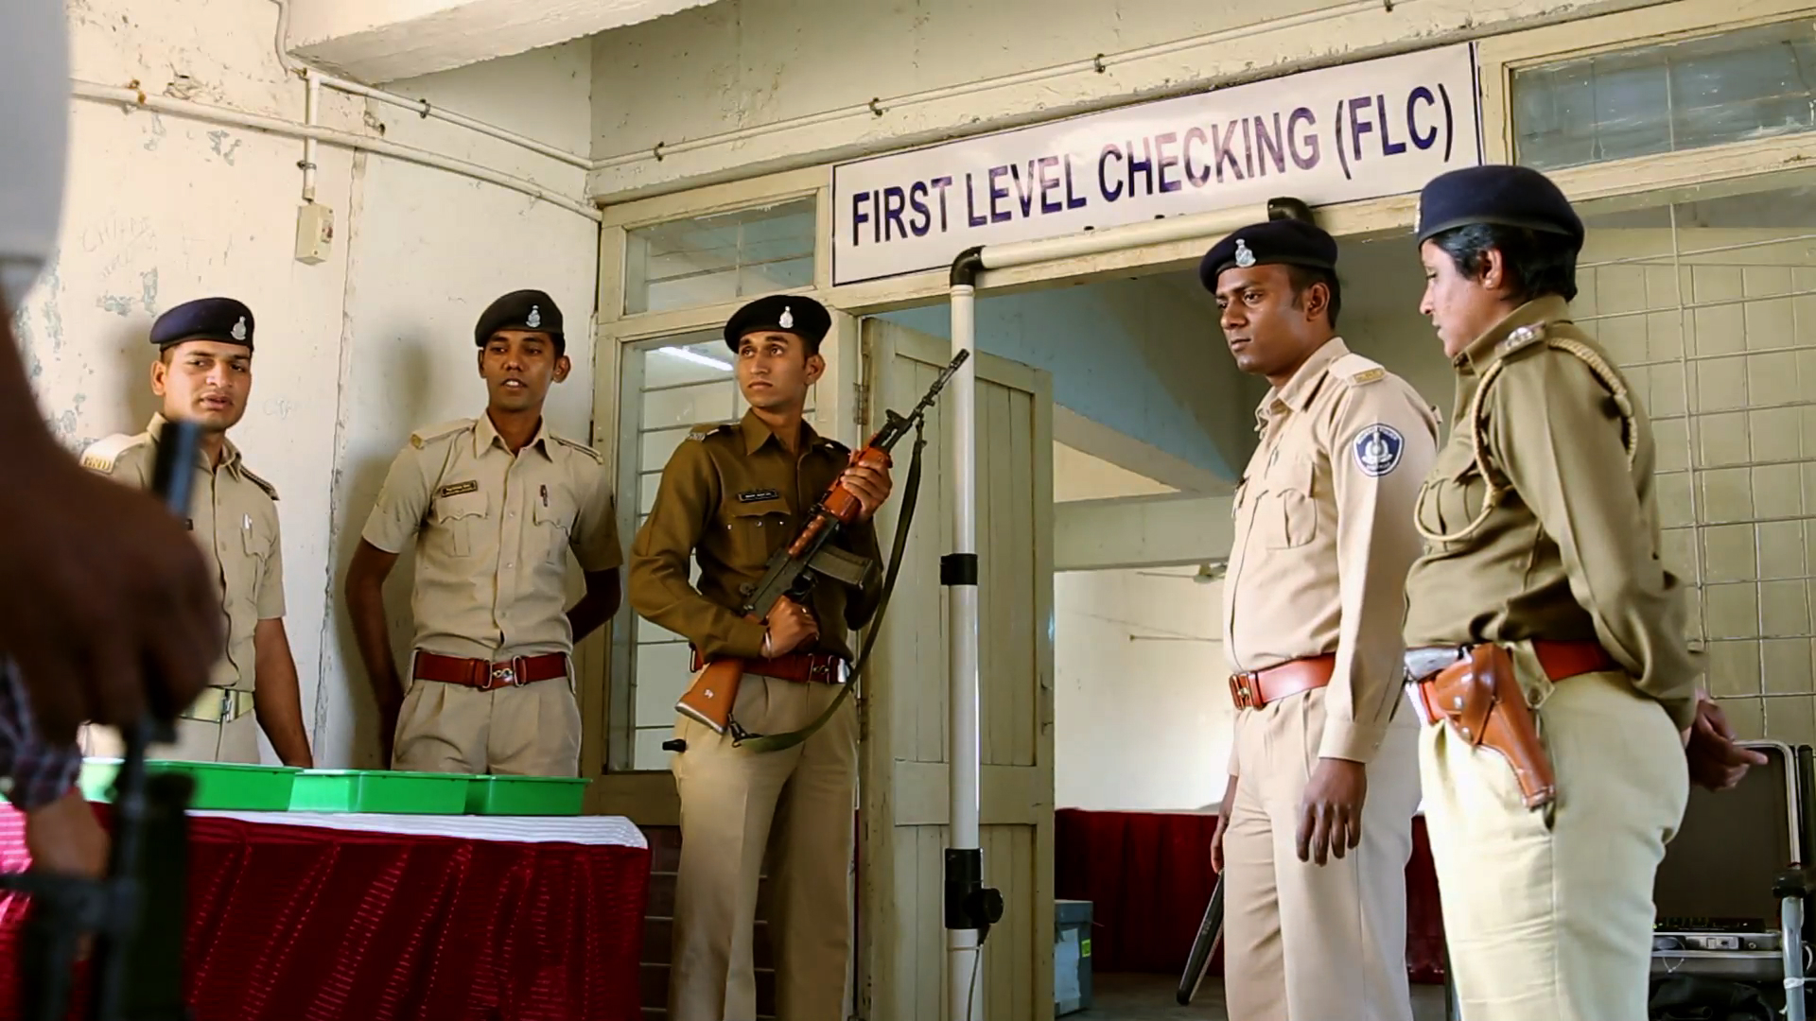
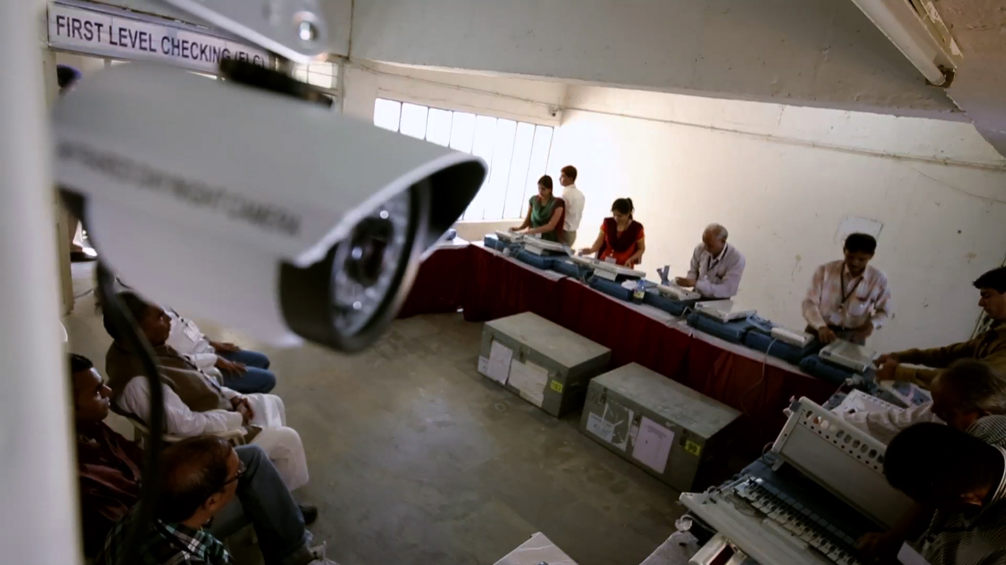
3. FIRST LEVEL CHECKING (FLC)
FLC is mandatorily done in the presence of representatives of political parties.
Fully sanitized hall under videography and full security.
Full functionality and behavioural check is done on every EVM.
Defective (non-functional) EVMs are kept aside and not used in election.
FLC status captured in EMS.
Notes:
Each EVM undergoes a first level check in a fully sanitized hall in the presence of political parties.

Slide 17
FLC PROCESS
Complete physical check up (switches, cable, latches etc) & functional test
Higher vote mock poll on randomly selected 5% EVMs. (1200 votes in 1%, 1000 in 2% & 500 in 2%)
CU sealed after FLC using ‘Pink Paper Seal’
EVMs/VVPATs stored in Strong Room under 24X7 security
2
4
6
8
1
3
5
7
Mock Poll on All EVMs/VVPATs
Electronic Result in CU is tallied with VVPAT Slip count and results shared with representatives
Signing on seals by Engineers and representatives
Photocopies of record registers shared with political party representatives
Notes:
FLC entails complete physical and functional check. Dummy symbols loaded on each EVM & VVPAT which is then subjected to a mock poll. Additionally 1% randomly selected EVMs undergo a mock poll of 1200 votes, 2% of 1000 & 2% of 500 votes. Results of mock poll are printed and shared with representatives. CU is then sealed with Pink Paper Seal and EVMs moved to the Strong Room.

Slide 18
4. RANDOMIZATION (1/4)
EVMs are Randomized twice using EMS.
No human intervention in randomisation.
Only FLC approved EVMs as per EMS get picked up for first randomisation.
1st Randomization
Done after FLC
To allocate EVMs from district, randomly, to a particular AC/AS.
In presence of representatives of political parties.
List of AC/AS-wise Randomized EVMs shared with political parties.
Notes:
EVMs undergo two stage randomisation using EVM Tracking Software, first while being allotted from district to ACs,

Slide 19
4. RANDOMIZATION (2/4)
EVMs are Randomized twice using EMS.
No human intervention in randomisation.
Only FLC approved EVMs recorded in EMS get picked up for first randomisation.
1st Randomization
2nd Randomization
Done just before ‘candidate setting’.
To allocate EVMs available in an AC/AS to polling stations.
In presence of candidates/election agents and list shared.
Notes:
and then from AC to Polling Stations. The list of allotted EVMs are shared with political parties or candidates.

Slide 20
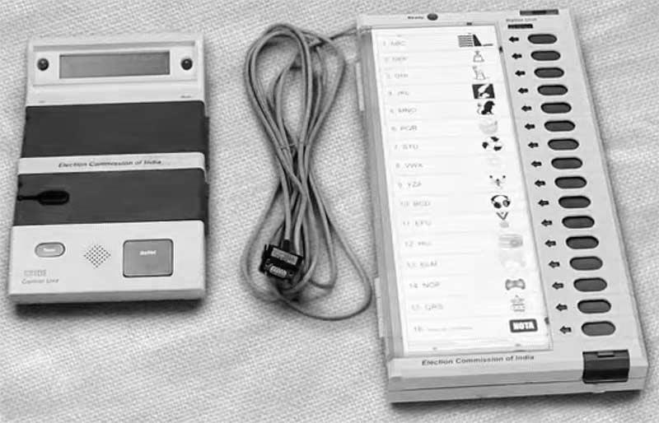
4. RANDOMIZATION (3/4)
PS1
1st Randomization
2nd Randomization
District
AC 1
PS2
AC 2
PS(n)
AC (n)

Slide 21
4. RANDOMIZATION- THE FOUNDATION OF EVM SECURITY (4/4)
Till first randomization- no one knows which EVM is going to which Constituency.
Till nomination finalization- no one knows the sequence of names on the ballot paper.
Hence, till candidate setting no one (not even RO/DEO/CEO/Commission) knows which button on which BU will be assigned to which candidate, making even an attempt to tamper absolutely futile.
Till 2nd Randomization- no one knows which EVM will go to which PS.
Added to this is the 3 stage Randomization of polling officials to different polling stations.
Notes:
As you can appreciate, till first randomisation no-one can predict which EVM will go to which AC. In addition, no-one knows the sequence of names on the ballot paper till the finalisation of list of contesting candidates as the names are placed alphabetically first for National & State Parties, followed by other Recognised Parties, followed by independents. Hence till candidate setting no-one, not even RO or DEO or CEO or the Commission could know which button on which BU will be assigned to which candidate. Again till 2nd randomisation no one knows which EVM will go to which Polling Station.

Slide 22
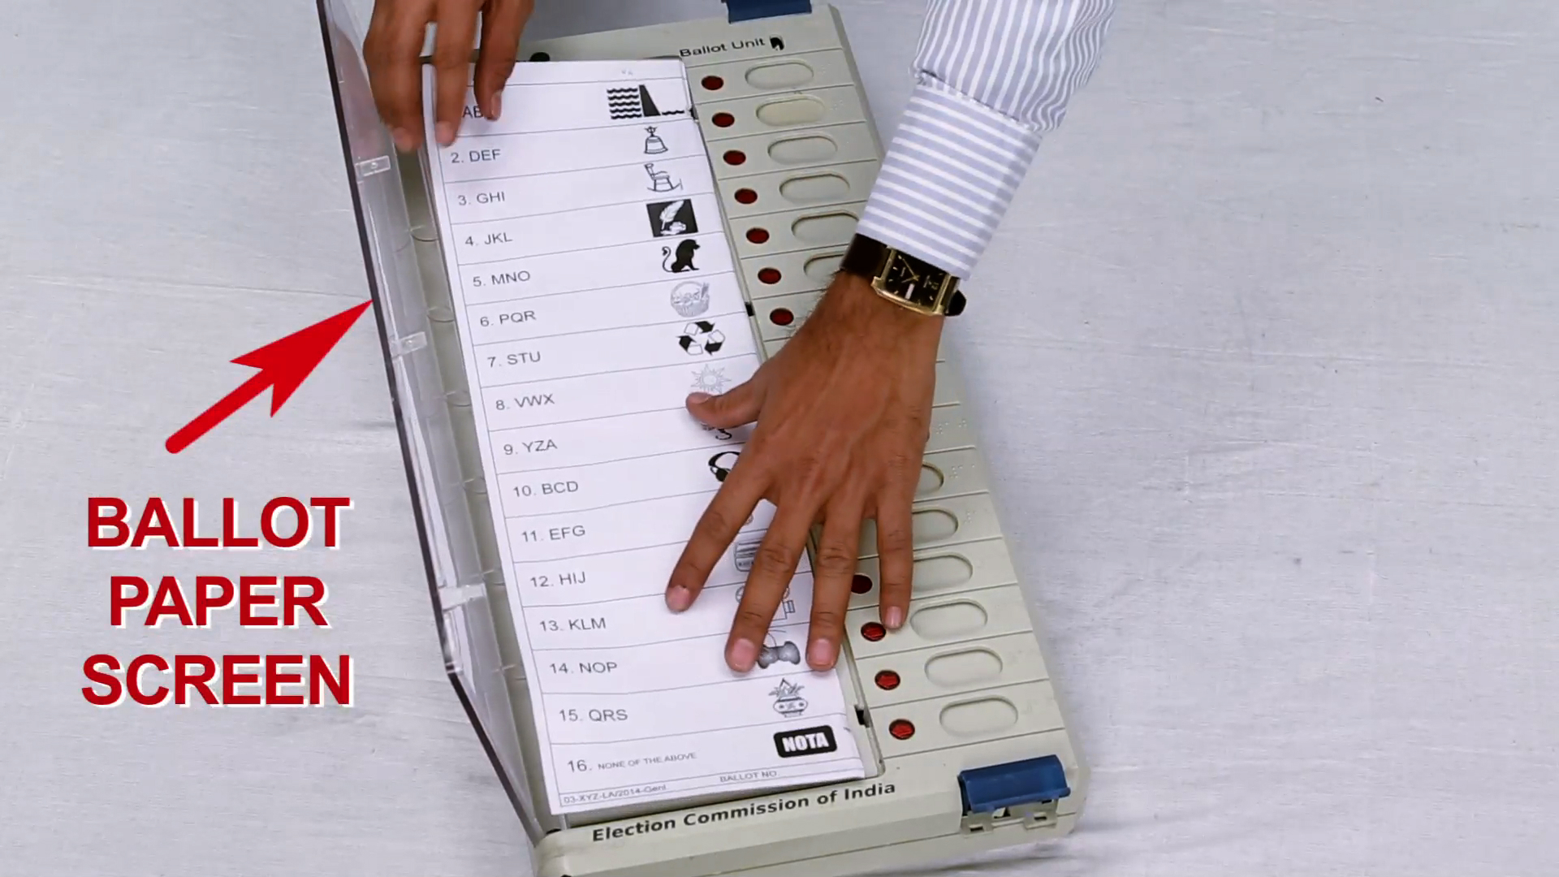
5. CANDIDATE SETTING
The Process
Insert ballot paper in the Ballot Unit & Set Number of Candidates
Seal Ballot Unit
Mock Poll on Every EVM with VVPAT +
1000 vote on 5% EVMs with VVPATs
Security Measures
1
Done only after finalization of the names of contesting candidates.
2
Fully sanitized hall under videography and full security.
3
Done in the presence of candidates or their agents.
Notes:
Yet another significant safeguard is the process of candidate setting which is done after the finalisation of contesting candidates. A ballot paper is inserted in the Ballot Unit which is then sealed with Pink Paper Seal. BU is sealed at this stage. Candidates symbols are also loaded in each VVPAT at this stage. Once again every EVM is subjected to mock poll and 5% EVMs are randomly picked up for 1000 mock poll.

Slide 23
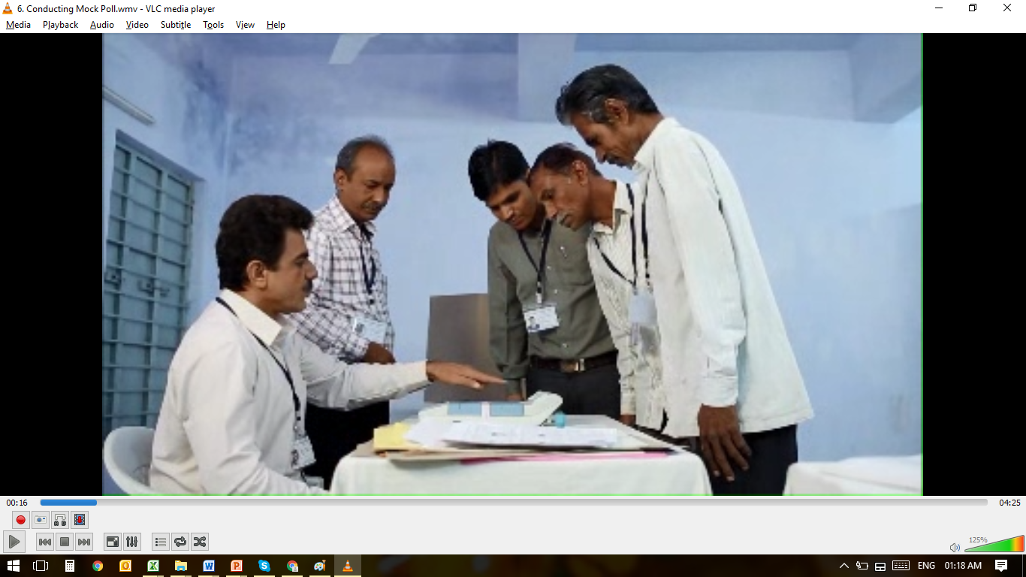
6. MULTIPLE MOCK POLLS
Each EVM undergoes mock poll during FLC, and again during Candidate Setting. In addition 10% EVMs are randomly picked up for higher vote (500-1200) mock poll.
10% EVMs randomly taken out for Training and Awareness undergo Mock Polls several times. During LSE 2019 approx 9 crore mock votes cast and checked on around 1 lakh EVMs during awareness camps.
Before start of actual poll, Mock poll on each EVM with at least 50 votes in the presence of polling agents.
Notes:
On the day of the poll mock poll is conducted with atleast 50 votes in the presence of the Polling Agents

Slide 24
7. POLL DAY CHECKS
Polling Agents
Central Armed Police Force (CAPF) and Micro Observers deployed at poling stations.
Web Casting/CCTVs
Frequent visits (Sector Officers /Senior officers/ Observers)
2 hourly reporting of votes polled
Media vigil
Notes:
Multiple measures are put in place on the poll day to further strengthen the poll process.

Slide 25
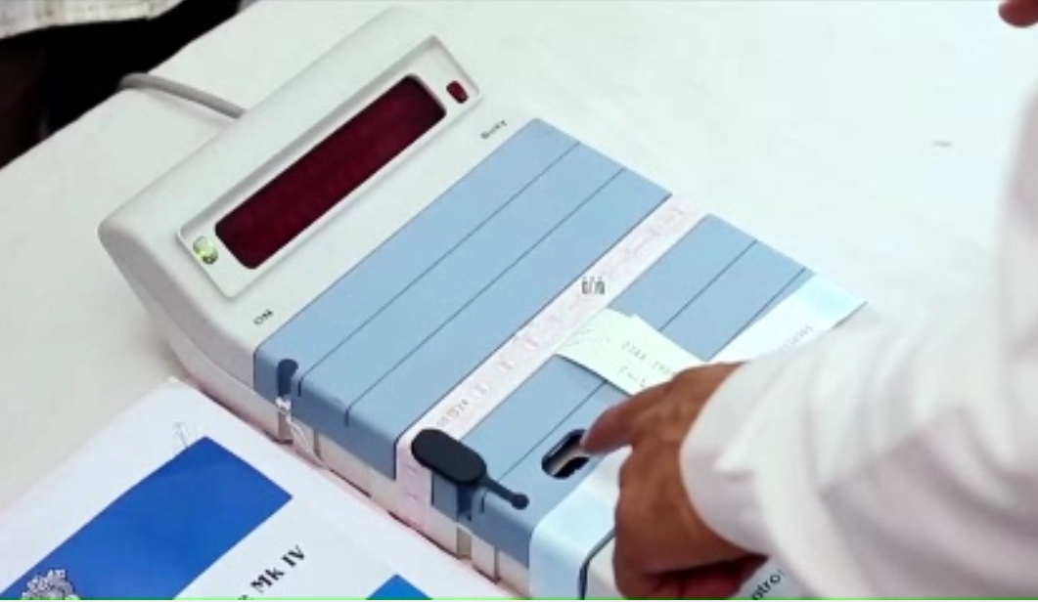
8. POLL CLOSURE & TRANSPORTATION
Poll Closed on EVM by pressing CLOSE button – EVM cannot accept any further vote.
EVMs sealed in carrying cases & polling agents sign on them.
EVMs transported back to the reception centres under armed escort. Candidates’ representatives are allowed to follow them.
Notes:
After the poll any further voting on EVM is disabled by pressing CLOSE button on CU.

Slide 26
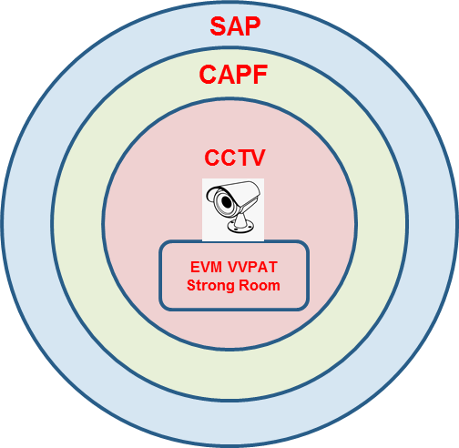
9. SECURE STORAGE IN STRONGROOMS TILL COUNTING
Polled EVMs kept in strong room, sealed in the presence of the Candidates and Observer.
Facilitation for Candidates to watch the Polled EVM Strong Room 24/7.
Starting from FLC of EVMs to Counting of votes, EVMs are kept in Strong-room with full 24/7 security.
Notes:
In addition arrangements are made for candidates or their agents to watch strong room 24/7 till the counting day.

Slide 27
10. STORAGE & SECURITY (1/3)
EVM Warehouse/Strongroom with only One Entry Point.
Entry secured by a Double Lock System with DEO & Dy DEO, each having custody of keys of one lock each.
24X7 Armed security.
The opening & closing of EVM warehouse ONLY in presence of Political party representatives- advance written intimation mandatory.
Every EVM/VVPAT moved is managed by ECI through EMS.
Post Polling:
Polled EVMs/VVPATs are stored in strong room having double lock system.
Candidates allowed to put their own seals on locks.
Notes:
Elaborate security protocol, both during election as well as non-election period, clubbed with the transparency protocol mandating written intimation to political parties and candidates everytime the warehouses are opened ensure that no-one can access the EVMs at any time. This security protocol is strengthened multifold while storing polled EVMs with CAPF, CCTV & Candidates Watch.
In addition ECI undertakes annual physical verification of entire EVM stock across the country.
However, All Political parties are also requested to kindly keep an eye on EVM warehouses even during non-election period

Slide 28
10. STORAGE & SECURITY (2/3)
Various layers of security of polled EVMs/VVPATs
Unique ID of BUs, CUs & VVPATs shared with political parties/candidates.
Sealing of CU and BU with Pink Paper Seals at FLC and commissioning respectively on which political parties and candidates put their signatures.
Sealing of EVMs/VVPATs before starting actual poll on which polling agents also put their signatures.
Seals on carrying cases of EVMs/VVPATs after closing of poll on which polling agents also put their signatures.
Notes:
Elaborate security protocol, both during election as well as non-election period, clubbed with the transparency protocol mandating written intimation to political parties and candidates everytime the warehouses are opened ensure that no-one can access the EVMs at any time. This security protocol is strengthened multifold while storing polled EVMs with CAPF, CCTV & Candidates Watch.
In addition ECI undertakes annual physical verification of entire EVM stock across the country.
However, All Political parties are also requested to kindly keep an eye on EVM warehouses even during non-election period

Slide 29
10. STORAGE & SECURITY (3/3)
Double lock system at the door of strong room on which candidates also put their own seals.
CCTV feed to Candidates Camping Area to monitor strong room.
Two Cordoned round-the-clock security (Inner perimeter manned by CAPF and Outer perimeter by State Armed Police.
Log-book and videography of officers inspecting the two cordons daily.
24/7 security arrangement for unused EVMs also.

Slide 30
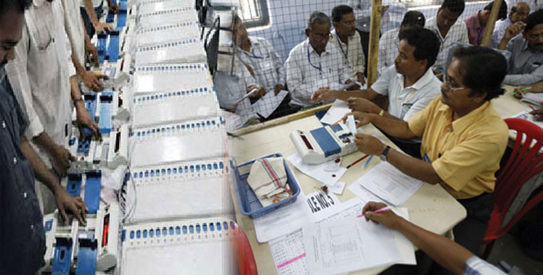
11. COUNTING DAY PROTOCOL
On the day of counting, strong room opened in the presence of Candidates, RO and Observer under videography.
Round-wise CUs are brought to the counting tables from Strongrooms under CONTINUOUS CCTV Coverage.
Unique ID number of the CU & the signed seals are verified and shown to the polling agents.
EVMs & VVPATs are stored back in Strong Room in the presence of candidates/their representatives till the completion of the Election Petition period.
Notes:
On the counting day CUs are moved under cctv and its seals verified by the polling agents before taking out results. Post counting EVMs are moved back to strong rooms.

Slide 31
ELECTION PETITION PERIOD
REGISTERING COMPLAINT

Slide 32
ELECTION PETITION PERIOD
Election Petitions can be filed within 45 days of result declaration.
EVMs (BU+CU) & VVPATs remain under sealed conditions till EP position is ascertained.
EVMs and VVPATs under EP, are kept under safe custody of DEO (Strong Room) till final disposal of EP.
Print on VVPAT Slips remains for 5 years.
Remaining EVMs and VVPATs not in EP are now free for re-use.

Slide 33
EVM Management System (EMS)
In house EVM Stock Management Software
Barcode of every EVM is scanned into EMS every time it moves from one Warehouse to another
All EVM Allocations done on EMS
FLC status(OK/Rejected) captured in EMS
EVMs Randomisation twice on EMS
EVM sent for repair captured in EMS
EVMs under EP marked in EMS

Slide 34
DEBATE AROUND EVMs-EXPLAINED!
CLARIFICATION ON ALL ISSUES

Slide 35
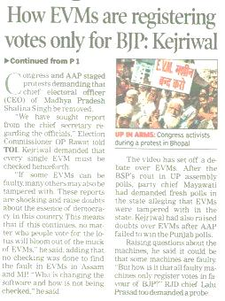
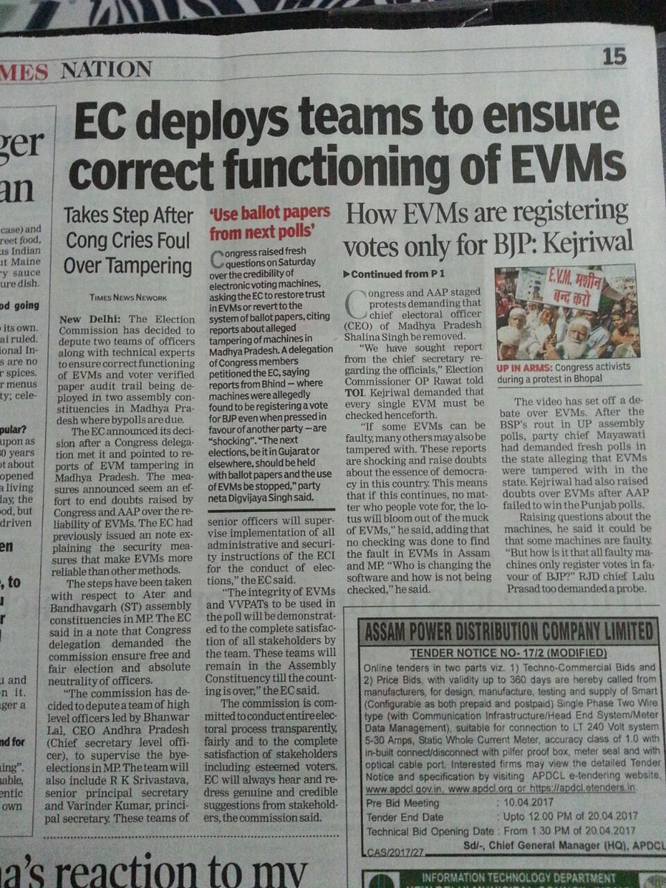
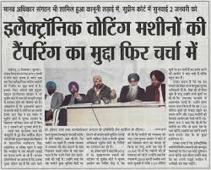
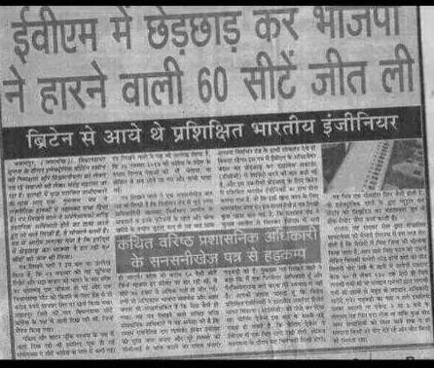
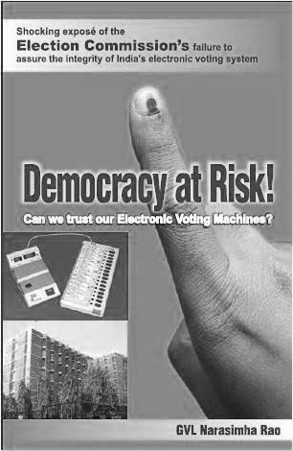
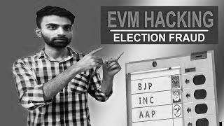
DOUBTS CREATED AROUND EVM
Hacked EVM
Vote Stuffing after Poll Closure
Remotely Altered Control Unit Display
Altered software code
International Comparison
Memory Manipulation
Replaced Microcontroller or Memory chips

Slide 36
NO POSSIBILITY OF EVM HACKING
‘Hacking’ is unauthorised access to or control over computer network security systems for some illicit purpose.
In the case of ECI EVMs, the word ‘Hacking’ is not applicable for following reasons:
The EVM is a stand-alone machine and is not connected to any network through wire or wirelessly.
The SW programme in the OTP Microcontroller can neither be read nor modified.
Notes:
We would urge that the word ‘hacking’ is not used by anyone

Slide 37
NO POSSIBILITY OF REMOTELY ALTERED DISPLAY THROUGH WIRELESS COMMUNICATION
It is alleged this can be done by either replacing the original display module with another display fitted with a wireless device or inserting an extra circuit board which can communicate with an external unit via a wireless device and tamper the result by controlling the CU display used for declaring the result.
Such a modification would require unfettered access to the EVM after FLC – Ruled out.
Notes:
Another aspersion is that the result display can be altered remotely through bluetooth, wifi, etc.

Slide 38
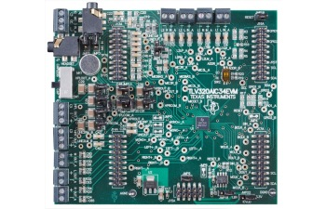
MEMORY MANIPULATION RULED OUT
It is alleged that voting data can be altered by clipping a Memory Manipulator IC to the memory chip where Vote data is stored.
This would need,
Full and free access to CUs after the Polling is over- Ruled Out !!
Breaking the seals and locks of the strong room in the presence of two layers of security plus the representatives of the candidates camping near the strong room- Ruled Out !!
Notes:
Yet another allegation says that

Slide 39
REPLACEMENT OF MICROCONTROLLER/MEMORY CHIP or MOTHERBOARD IMPOSSIBLE
Administrative Safeguards
Chip replacement would require access to EVM Warehouses – Ruled Out.
Any chip replacement before FLC will get caught during FLC.
Chip Replacement after FLC would require access to Strong Rooms and breaking of EVM Pink Paper seals– Ruled Out.
Technical Security
BUs and CUs communicate only amongst themselves and go into error mode if connected to any other machine. Thus, any modified EVM (with microcontroller /memory changed) would not be usable even if someone is able to hypothetically bypass security arrangements and modify EVM.
Notes:
A few naysayers allege that EVM can be tampered by replacing the micro-controller or the memory OR EVEN THE FULL MOTHERBOARD. However both administrative safeguards as well as tech security rule that out.

Slide 40
TAMPERED SOURCE CODE “TROJAN” RULED OUT
It is alleged that Trojan can be introduced in the following manner
by reprogramming the chip, or
by the chip manufacturer during fusing of the software.
Re-programming Ruled Out as these are OTP chips.
Code tampering by the chip manufacturer Ruled Out as it will get caught during the code integrity check.

Slide 41
NO POSSIBILITY OF VOTE STUFFING AFTER POLL CLOSURE
Administrative safeguards
Poll closed by pressing the “CLOSE” button on the CU after last vote, Representatives of candidates who are present signs on the seals.
EVM seals checked on counting day.
What if seals broken and votes stuffed while transporting?
EVM does not accept any votes after CLOSE button pressed in CU.
What if CLOSE button not properly pressed and Votes Stuffed while transporting?
Poll Closure time recorded in the PO’s diary and any votes polled in the EVM after this time can be identified due to time stamping of key presses.

Slide 42
DEFECTIVE VS TAMPERED

Slide 43
DEFECTIVE/NON-FUNCTIONING VS MANIPULATION/TAMPERED (1/2)
Tampered machine is one which would behave in a predefined biased manner to favor someone.
Malfunctioning machine is one which would randomly behave erroneously, but without a predefined biased manner.
Defective or Non-functioning machine is one which becomes in-operative.
While 1-2% EVMs may become Defective/Non-functional (and are replaced with good EVMs), no case of Malfunctioning EVM (i.e. one recording wrong vote) ever reported.
Question of Tampering absolutely ruled out due to several layers of technical and administrative safeguards.

Slide 44
DEFECTIVE/NON-FUNCTIONING VS MANIPULATION/TAMPERED (2/2)
Defective/Non-functional | Manipulation/Tampering
An EVM can be said defective/non-functional, if they do not work due to any mechanical/electronic fault. | An EVM can be said manipulated/Tampered, if someone has made unauthorised alteration to interfere in its working. The same is ruled out due to technical security implemented in EVM and administrative safeguards prescribed by ECI.
Dictionary meaning- ‘Failing to work or function properly’. | Dictionary Meaning- ‘to interfere in an illegal & disruptive manner or to make alterations or adjustments, especially secretly so as to subvert an intended purpose or function.
EVMs, like any other machines can become non functional. Such defects get detected during the 3 mock polls and are replaced. | A tampered EVM must behave in a pre-defined and biased manner to favour a particular candidate and this partisan behaviour of the machine must be replicable/demonstrable.
All such defective EVMs are promptly removed from the election process and replaced with a full functional EVM. | No evidence of any incident of any EVM Tampering, ever has been produced.
However, No incident of EVM tampering ever found.
Notes:
The two terms – defective and tampered – are often interchangeably used, WRONGLY.

Slide 45
DEFECTIVE EVM PROTOCOL
Defective EVMs
EVMs that fail to function due to any mechanical, structural or physical defect like faulty switches, broken button, faulty connections etc.
However, these NEVER record Wrong Vote.
EVMs are checked for defects 3 times - during FLC, candidate setting, before start of poll.
Serial Numbers and defects of these EVMs are noted and EVMs are sent to the manufacturers for analysis and repair.
Manufacturers follow same security protocols during repair as they do for manufacturing new EVMs.
Notes:
All EVMs found defective are sent to manufacturers for analysis and repair. Manufacturers follow same security protocols during repair as they do for manufacturing new EVMs.

Slide 46
Electronic Voting in Other Countries

Slide 47
VARIOUS FORMS OF ELECTRONIC VOTING IN OTHER COUNTRIES
Electronic Voting (Fully /Partially)
19 Countries using electronic voting in some form through EVMs (Direct Recording Machines), some with Paper Trail.
India, USA, Canada, Australia, Belgium, Bulgaria, Italy, Switzerland, Mexico, Brazil, Chile, Peru, Venezuela, Armenia, Namibia, Nepal, Bhutan, Bangladesh.
Electronic Counting
13 Countries are using e-technology for counting of votes
Argentina, Brazil, Venezuela, Dominican Republic, Lithuania, Bulgaria, Belgium, Australia, South Korea, Philippines, Mongolia, Bhutan, Namibia.

Slide 48
Country Specific Details
Other countries using EVMs (DRMs):
USA, Australia, Belgium, Bulgaria, Italy, Switzerland, Canada, Mexico, Argentina, Brazil, Chile, Peru, Venezuela, Namibia, Nepal, Bhutan, Armenia, Bangladesh.
Currently, in the USA, the Direct Recording Machines are used in 27 states, among which paper audit trails are used in 15 states.
The other voting methods include: Optical Scan Paper Ballot Systems, Ballot Marking Devices, and the Punch Card Ballot.

Slide 49
Why Some Countries Discontinued Electronic Voting

Slide 50
ECI EVM | Foreign EVM
Standalone | Mostly networked
Manufactured in Premium PSUs | Manufactured entirely by private entities
Verified and certified by an independent Technical Experts Committee | No such robust and independent certification/ checks
Data is stored internally and not transferrable by any device | Voting data recorded in the DRM is transferred by means of CD, etc
Full end to end security protocol and administrative safeguards for the use, storage, transportation and tracking | No such protocols, e.g. in Ireland
Administrative and physical security as per legal framework across the country. | No such legal framework, e.g. in Netherlands
Voter verifiability and auditability of every vote cast | Lack of such facility in the NEDAP machines- un-Constitutional by German Supreme Court as lacked public examinability
Notes:
In the notes we have clearly spelt out how ECI EVMs are far superior to any EVMs worldwide. While most EVMs used in foreign countries are internet connected only a few country like Germany, Netherlands Ireland, Brazil, Namibia etc. used standalone EVMs. However Germany , Netherland and Ireland stopped using EVMs as these were privately manufactured and they had no independent certification system unlike a very robust verification and certification system through independent TEC in case of ECI EVMS. Also voting data in these NEDAP EVMs was transferred using CDs, unlike our EVMs where it is stored internally. Also these countries lack full end to end administrative safeguards as well as legal framework. Finally their EVMs also lack auditability

Slide 51
ASPERSIONS VS CONFIDENCE
Between MAR-DEC 2017

Slide 52
BHIND FINDINGS
Commission’s enquiry found 4 buttons of BU pressed in the following order and VVPAT printed corresponding slips-
Button no | Symbol | Name of Candidate
03 | Handpump | Raju Pal
04 | Lotus | SatyaDev Oanchori
03 | Handpump | Raju Pal
01 | Hand | Ambuj Shukla
It is pertinent to mention here that it is completely false to say that multiple times slips of lotus were printed during the demo on 31st March as alleged.
Notes:
As can be seen, the 4 buttons pressed and 4 slips printed clearly shows that there was nothing wrong with EVMs or VVPAT. The allegation that VVPAT printed the same symbol irrespective of the button pressed is completely false. However, the SOP of conducting FLC even before using any EVM for training or demonstration was missed at Bhind and as a result the previously loaded symbols in VVPAT were not erased before the demo. As a result the VVPAT printed the symbols and names corresponding to Kanpur AC.

Slide 53
Between March-May 2017
120 Petitions Received
41 alleging wrong results
17 Related to SEC
Evidence Sought from 24
Reply by 3
Evidence by none
Notes:
Since 11 Mar 120 petitions have been received by the Commission. 41 of these alleged wrong results. 17 of these relate to SECs. We had sought evidence from remaining 24 but while 3 have responded, none have given any evidence of tampering.

Slide 54
EVM CHALLENGE- 2017 (1/2)
Commission organized an EVM Challenge on 3rd June 2017.
All National and State Political Parties invited to participate in the Challenge.
Parties allowed to pick EVMs/VVPATs of their choice from the 5 poll-gone States (UP, Punjab, UK, Goa, Manipur), which were securely held in the Strongrooms under 24*7 armed security.
Parties given opportunity to demonstrate EVM manipulation/tampering in the votes recorded in the EVMs/VVPATs of their choice, as variously alleged earlier.

Slide 55
EVM CHALLENGE- 2017 (2/2)
NO Political Party participated in the Challenge.
Only 2 parties i.e. NCP & CPI-M reported to venue, ONLY TO UNDERSTAND THE EVM PROCESS BETTER and were given detailed briefing.
The credibility and integrity of ECI-EVMs has always remained perfectly intact and unscathed.

Slide 56
Aspersions in the 5 State Assembly Elections Nov-Dec 2018: (1/2)
 | Allegation/Aspersion | Fact | Action Taken
1. | In Khurai (Madhya Pradesh) some reserve EVMs and VVPATs reached the strong room 48 hours after the polling was completed. | Violation of ECI instructions for deposition of all Reserve EVMs/VVPATs on the same day. However no impact on secured storage of polled EVMs. | Returning Officer and Assistant Returning Officer of Khurai were suspended.
2. | CCTV cameras outside the EVM strong room in Bhopal, MP did not function from 8.19 am to 9.35 am on 30th November, 2018 - allegations of manipulations. | Due to power failure in the area, the recording could not be done. However no impact on secured storage of polled EVMs, as there are 7 layered security. | An inverter and a generator were installed in order to ensure continuous power supply.
3. | A Security personnel allegedly found using Laptop outside EVM strong room in Bemetara district of Chhattisgarh. | Laptop can never connect to an EVM. Manipulation in EVMs stored inside Strongroom by laptop outside the building absolutely ruled out. | Sub-inspector of the 175th battalion of the BSF was replaced.

Slide 57
Aspersions in the 5 State Assembly Elections Nov-Dec 2018: (2/2)
 | Allegation/Aspersion | Fact | Action Taken
4. | A sector officer with Reserve EVM at a private hotel owned by a candidate in MP. | Sector Officer halted at night at a private hotel-Violation of ECI instruction. However all seals were intact, and the Reserve EVM not used. | EVM taken out of election system. Sector Officer suspended.
5. | 1 EVM was alleged to be found at a candidate’s residence in Pali, Rajasthan. | Sector Officer had gone to his house, which was close to the candidate’s house. Violation of ECI Instructions. However all seals were intact, and the Reserve EVM not used. | EVM taken out of election system. The Sector Officer was suspended and the Returning Officer, Pali was transferred.
6. | 01 reserve EVM found lying on road in Baran district (Kishanganj AC) in Rajasthan. | Fallen from the jeep while transpoting. Violation of secure EVM transportation protocol. | EVM taken out of election system. Patwari and Inspector were suspended.

Slide 58
Aspersions in the Lok Sabha Elections 2019: (1/5)
 | Allegation/Aspersion | Fact | Action Taken
1. | Transporting of unused EVMs from Tezpur to the office of DC Kamrup (Rural), without inviting political parties at Kamrup. | Tezpur DEO failed to inform Kamrup (Rural) DEO before shifting of “Unused EVMs/VVPATs” to State Central Warehouse at Kamrup. | The Commission conducted an enquiry in the matter. Disciplinary action has been taken against DEO, Tezpur.
2. | News 18 alleged that EVMs found in the vehicle of City Magistrate Jhansi (Uttar Pradesh). | The said news pertained to unused EVMs, which were brought for storing in the strong room situated at Bhojla Mandi, Jhansi (Uttar Pradesh). | The said EVMs/VVPATs verified in front of the complainant candidates and they were fully satisfied. Thereafter, the said EVMs/ VVPATs stored in the respective strong rooms (different from Polled EVM Strong Rooms).

Slide 59
Aspersions in the Lok Sabha Elections 2019: (2/5)
 | Allegation/Aspersion | Fact | Action Taken
3. | Suspicious movement of EVMs in 60-Dumariganj PC of Uttar Pradesh. | The EVMs under question were unused EVMs. As per ECI instructions unused EVMs/VVPATs were being stocked at central locations for quickly shifting to subsequent phases whenever required. | The matter was explained to the contesting candidates by the District Election Officer and they were satisfied.
4. | Suspicious movement of 50 Ballot Units from Coimbatore to Theni, 20 VVPATs from Coimbatore to Erode and 20 Control Units and 30 VVPATs from Tiruvalllur to Theni. | Poll in the State of Tamil Nadu was held on 18.4.2019 and on 6th & 7th May, 2019, the unused reserve EVMs and VVPATs were moved under intimation to the political parties for the purpose of use in expected repoll in some polling stations. Some of the representatives of the political parties were also present during the actual shifting. | There was no violation of any instructions of the Commission, as the movement of EVMs was done as per instructions of the Commission.

Slide 60
Aspersions in the Lok Sabha Elections 2019: (3/5)
 | Allegation/Aspersion | Fact | Action Taken
5. | In mock poll at polling station No.31 of 34-Cuncolim AS of South Goa PC, 8 additional votes in favour of BJP instead of INC. | During mock poll, there was no complaint from the polling agents that the votes shown on VVPAT slip having any mismatch. However repeat Mock poll done, again with no mismatch between EVM and VVPAT slips count. | However, the set of machines was replaced with reserve set of machines and poll was held after conduct of mock poll to the satisfaction of candidates’ representatives.
6. | Pressing any button on EVM, vote goes to BJP. No Written complaint, just a vague statement in an interview to TV 9/TV 18 Lokmat News channels on 18/4/2019 at Solapur. | DEO clarified that the complaint is wrong and no such thing happened anywhere in Solapur PC. | A clarification was given to Lokmat TV 9 & TV 18 News channels. They immediately stopped broadcasting the wrong news.

Slide 61
Aspersions in the Lok Sabha Elections 2019: (4/5)
 | Allegation/Aspersion | Fact | Action Taken
7. | Theft of DVRs from the intermediate strong room of Umred AS of Ramtek PC on 12th/13th April, 2019. Allegation of wilful default in providing security to EVMs enabling the miscreants to lay their hands on EVMs and tamper with EVM. | DVRs and TVs installed at police guard room were not uninstalled while polled machines were shifted from intermediate strongroom, Umred to main strong room at Nagpur. Later DVRs found on 4th May, 2019 near temporary strong room, Umred. Forensic test of DVR established that there was no attempt to tamper with EVM. | Departmental action has been taken against the ARO & Tehsildars and explanation of DEO, Nagpur called. 1 year increment withheld for Police Inspector.
8. | News item that in PS in Lumani of Zunhebotu district, Nagaland only one button on ballot unit was getting lighted and the VVPAT slips showing the symbol of only one party regardless of the buttons pressed. | Sector Magistrate visited the said PS and investigated. It was found that the EVM was functioning normally and no variation was observed. | The facts of the matter were shared with the media during the press conference after the poll was over.

Slide 62
Aspersions in the Lok Sabha Elections 2019: (5/5)
 | Allegation/Aspersion | Fact | Action Taken
9. | EVMs kept at Badaun strong room have been tampered after breaking the seal of the strong room. | No such incident occurred. | CEO UP issued Press Note on 3rd May 2019 clarifying that no such incident actually occurred.
10. | Complaint that at PS No. 151 of 139—Kovalam AS of Thiruvananthapuram PC, Kerala, there was discrepancy between the button that was being pressed and the vote that was being actually cast. | No such incident occurred. Polling agents and polling parties inside the polling station were not even aware that such a news was spreading outside. | Sector Officer and ARO visited the PS. There was no issues. It was clarified by the DEO that such an information was false. Observer also arrived and explained to the candidates the false nature of the widespread complaint.

Slide 63
PAST JUDGEMENTS

Slide 64
JUDGEMENTS
Karnataka High Court 1999
‘This invention is undoubtedly a great achievement in the electronic and computer technology and a national pride’.
Madras High Court 2001
‘There is also no question of introducing any virus or bugs for the reason that the EVMs cannot be compared to personal computers.’
Kerala High Court 2002
The High Court recorded its appreciation on the efficiency of the mechanism of detecting votes cast by impersonators. Upheld by the Hon’ble Supreme Court in 2003.

Slide 65
Forensic Checking and Secured Storage
Bombay High Court: Order dated 23.02.2018:
The Bombay High Court ordered a detailed Forensic Examination of the EVMs from CFSL, Hyderabad for checking any manipulation etc. The CFSL report clearly ruled out any tampering, alteration or manipulation in the EVMs.
High Court of Madhya Pradesh: Order dated 05.12.2018:
In Writ Petition (Civil) No. 28016/2018 Naresh Saraf Vs ECI & Anr, Hon’ble High Court of Madhya Pradesh expressed satisfaction at the Security and Storage Protocols for EVMs and VVPATs established by the ECI and rejected petition to give directions for any changes.

Slide 66
Hon’ble Supreme Court: Dismissed Ballot Paper Request
Order dated 22.11.2018:
In Writ Petition (Civil) No. 1332/2018, Nyaya Bhoomi & Anr Vs ECI, Hon’ble Supreme Court dismissed the petition requesting for return to Ballot paper system.
Upon hearing the counsel the court made the following ORDER-
“Having heard learned counsel for the petitioners and upon perusing the relevant material, we are not inclined to entertain the writ petition. The same is, accordingly, dismissed.”

Slide 67
The Hon’ble Supreme Court on VVPAT counts
Order dated 08.04.2019:
“We are certain that the system ensures accurate electoral results.”
“Verification of VVPAT slips of 5 Polling Stations per Assembly Constituency or Assembly Segment in a Parliamentary Constituency would lead to greater satisfaction.”
Review Petition against above order dismissed on 07.05.2019.
Order dated 21.05.2019:
The Supreme Court on 21.05.2019 dismissed a PIL seeking counting of VVPAT slips of all EVMs while rebuking the petitioner NGO for making a “mockery of democracy” by moving the court despite a clear ruling by the apex court directing counting of VVPAT slips of five Polling Stations per assembly segment.

Slide 68
VOTER VERIFIABLE PAPER AUDIT TRAIL (VVPAT)

Slide 69
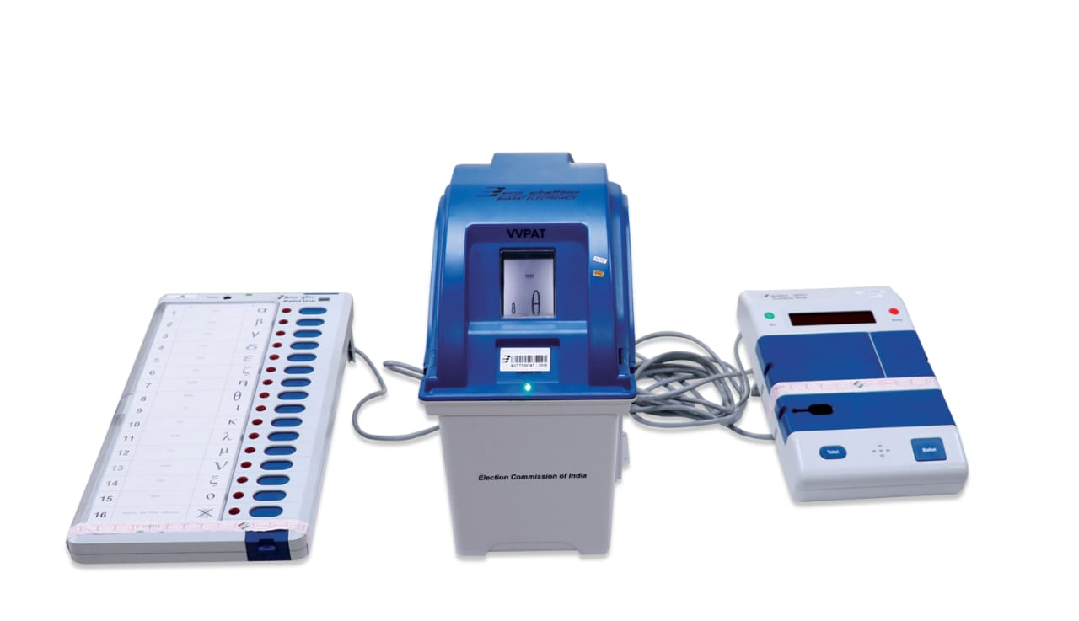
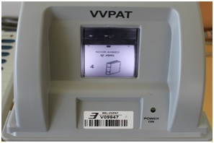
VVPAT
VVPAT- allows the voters to verify that their votes are cast as intended.

Slide 70
VVPAT
Voter Verifiable Paper Audit Trail is an independent system, attached with the Electronic Voting Machines, that allows the voters to verify that their votes are cast as intended.
When a vote is cast, the elector shall be able to view through the transparent window of the VVPAT, the printed paper slip showing the serial no, name and the symbol of the candidate of his choice.
The slip is visible through the VVPAT window after which it automatically gets cut and falls in the sealed drop box of the VVPAT.
Since June 2017, VVPATs are being used in all Elections.
Notes:
7070

Slide 71
HISTORY OF VVPAT
4th October 2010: An all-party meeting agreed to incorporate VVPAT with EVM.
14th August 2013: The Conduct of Elections Rules 1961 amended to use VVPAT.
September 2013: First used in Bye-election for 51-Noksen AC in Nagaland.
October 2013: Hon’ble Supreme Court allowed ECI to introduce the VVPAT system in a phased manner.
4th March 2017: Goa became the first State where 100% coverage of VVPATs with EVMs during Goa Legislative Assembly Election, 2017.
12th August 2017: In all party meeting, the Commission committed to ensure 100% coverage of VVPATs in all future elections.
April-May 2019: 100% Deployment of VVPATs in Lok Sabha Elections 2019.
Notes:
7171

Slide 72
VVPAT Complaint – Rule 49MA
In case a voter complains of wrong printing by VVPAT:
He will report to Presiding Officer.
Presiding Officer will take a declaration explaining that if found false he can be penalized.
PO will then record in 17A and permit him to cast a ‘test vote’ in presence of PO and Polling Agents.
If found false PO will record in 17A and 17C so that the test vote is not counted.
If found true then PO will stop poll and report to RO.
Since the introduction of VVPATs, more than 83 crore voters have cast their votes with full satisfaction & ONLY 17 (seventeen) complaints received u/r 49MA, which were all FOUND TO BE FALSE.

Slide 73
VVPAT RECOUNTING PROCESS
Counting of votes according to Rule 56C of Conduct of Election Rules,1961.
After announcement of result any candidate/ his agent may apply in writing to the RO for counting of paper slips of VVPAT under Rule 56D.
The RO shall pass a speaking order on whether the slip counting to be allowed.
Till date, in 16 (Sixteen) instances RO has allowed slip counting since 2017. All counts matched.

Slide 74
VVPAT RECOUNTING PROCESS
Between Dec 2017- Dec 2018 VVPAT slip count done in 1500 randomly selected PS and all these counts matched.
In 2019 Lok Sabha Elections 20,687 VVPATs counted and around 1.25 crore slips matched with EVM count. A total count variance of only 0.0004% found in 8 VVPATs, that too due to human errors and not machine errors, which are being looked into.

Slide 75
Why Going Back to Ballot not a Solution
Average around 2000 invalid votes in each Constituency when ballots used.
Vote stuffing was very easy with Ballot papers. EVMs designed to allow only 4 votes per minute ruling out vote stuffing.
Counting of Ballot Papers was always prone to manual errors. EVM counting both quick and accurate.
Retrograde step in the era of Technology when even financial transactions done electronically.
Ballot papers are made of wood pulp and hence made at a cost to environment.

Slide 76
THANK YOU

